Slide 1
PRESENTED BY: Ayesha Ishraq (16-Arid-0054) SUPERVISED BY: M. Zahid
ATTENDANCE SYSTEM
IOS APP

Slide 2
INTRODUCTION
Attendance System is an IOS application which allows teachers to mark attendances of classes of courses which they are teaching. And allows students and parents to view / review attendance of enrolled courses.

Slide 3
OBJECTIVES
The Objective is to give Teachers an application through which they can mark Attendance online of their Students.
Parents and Students can also View Attendance.
Director can lock attendance according to his choice and also set Percentage in which Attendance will get short.
Director can also view Attendance .
Admin has authority to allow or disAllow teachers by marking Attendance.

Slide 4
PROBLEM STATEMENT & PROPOSED SOLUTION
Problem Statement:
It was hard to mark Attendance on pages and also students cant see their attendance record throughout the semester.
Proposed Solution:
It provides Teacher to mark Attendance Online.
Parents have also authority to see their children Attendance.
It Also provide Authority to Admin and Director to view/review the Attendance.

Slide 5
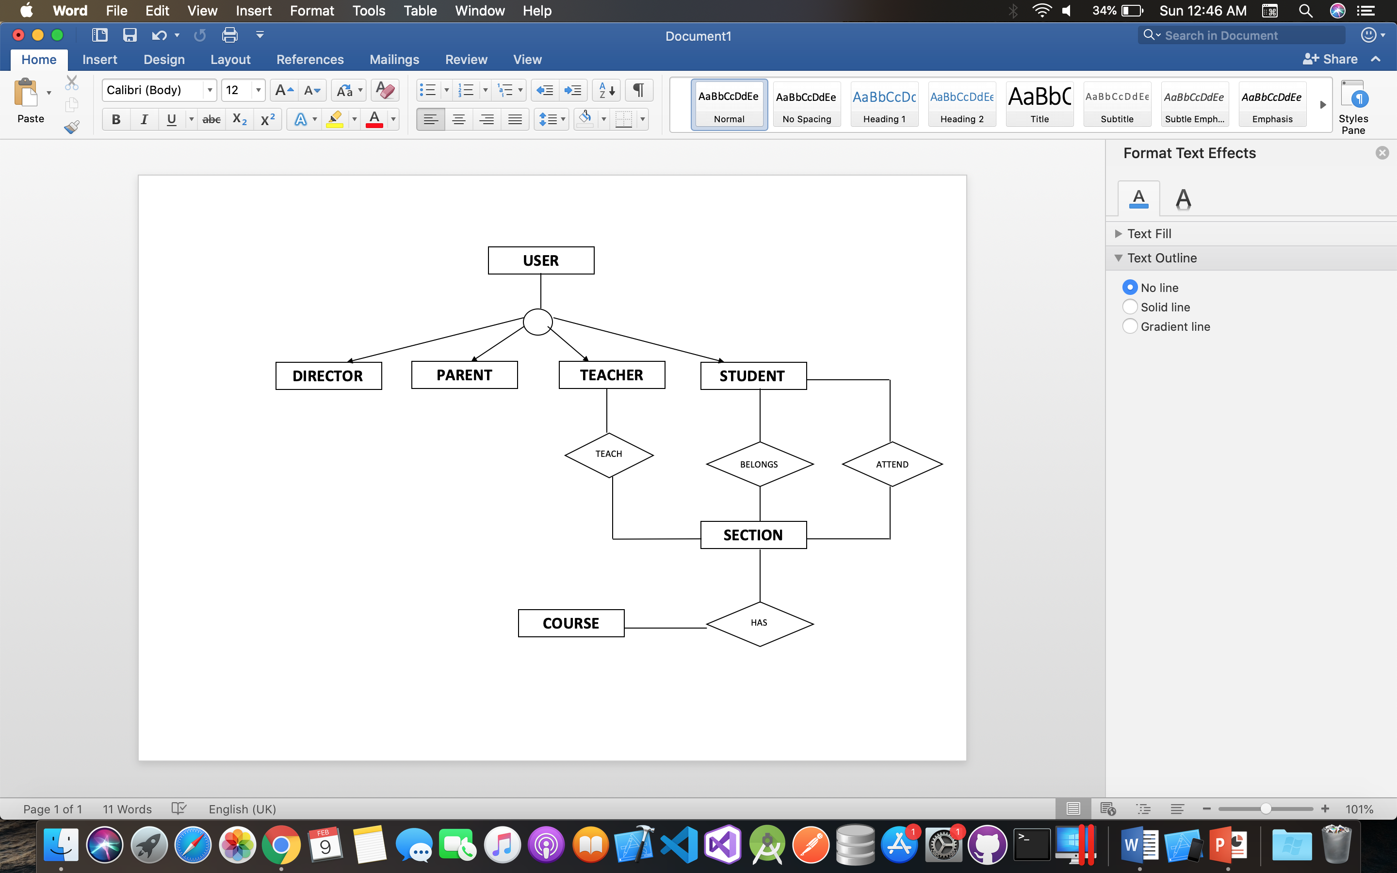
Entity Relationship Diagram (ERD)

Slide 6
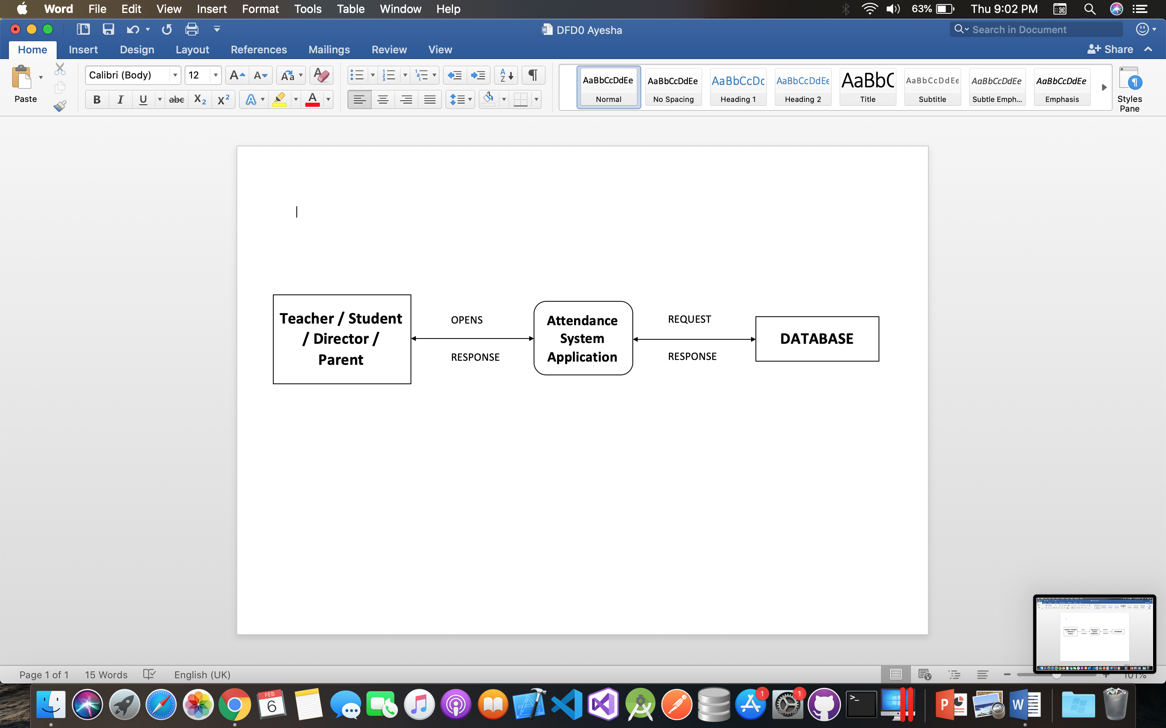
Data Flow Diagram (DFD)
Level 0:

Slide 7
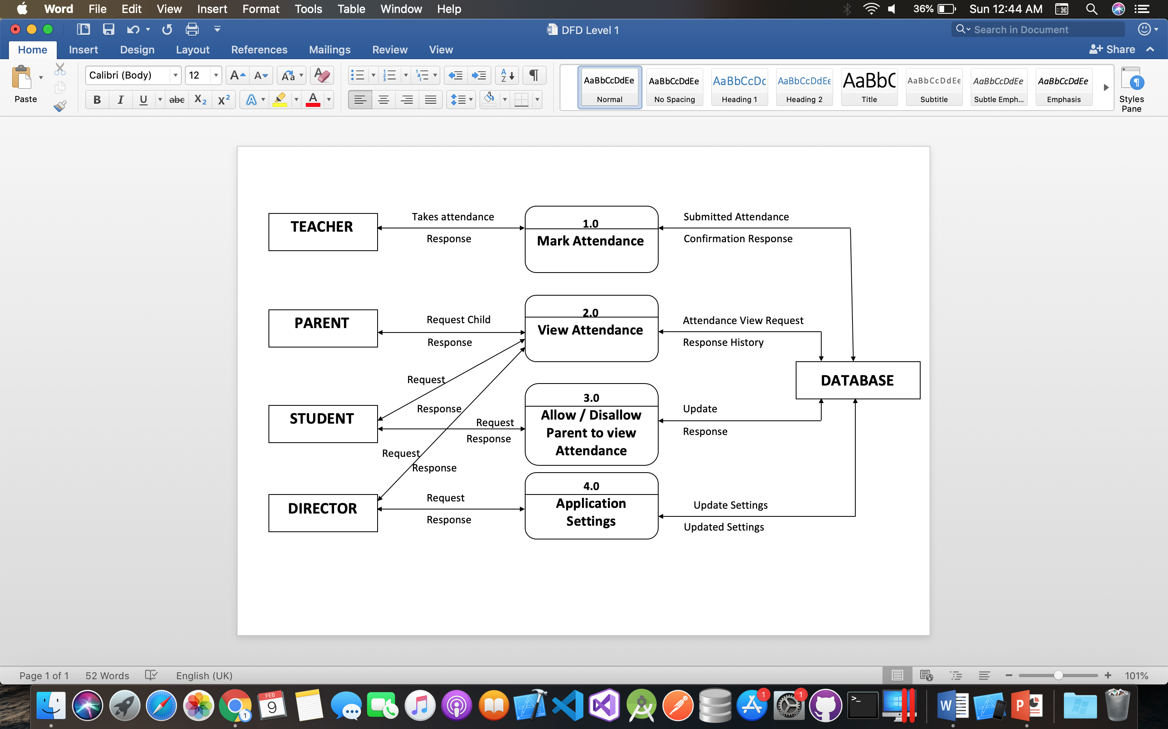
Data Flow Diagram (DFD)
Level 1:

Slide 8
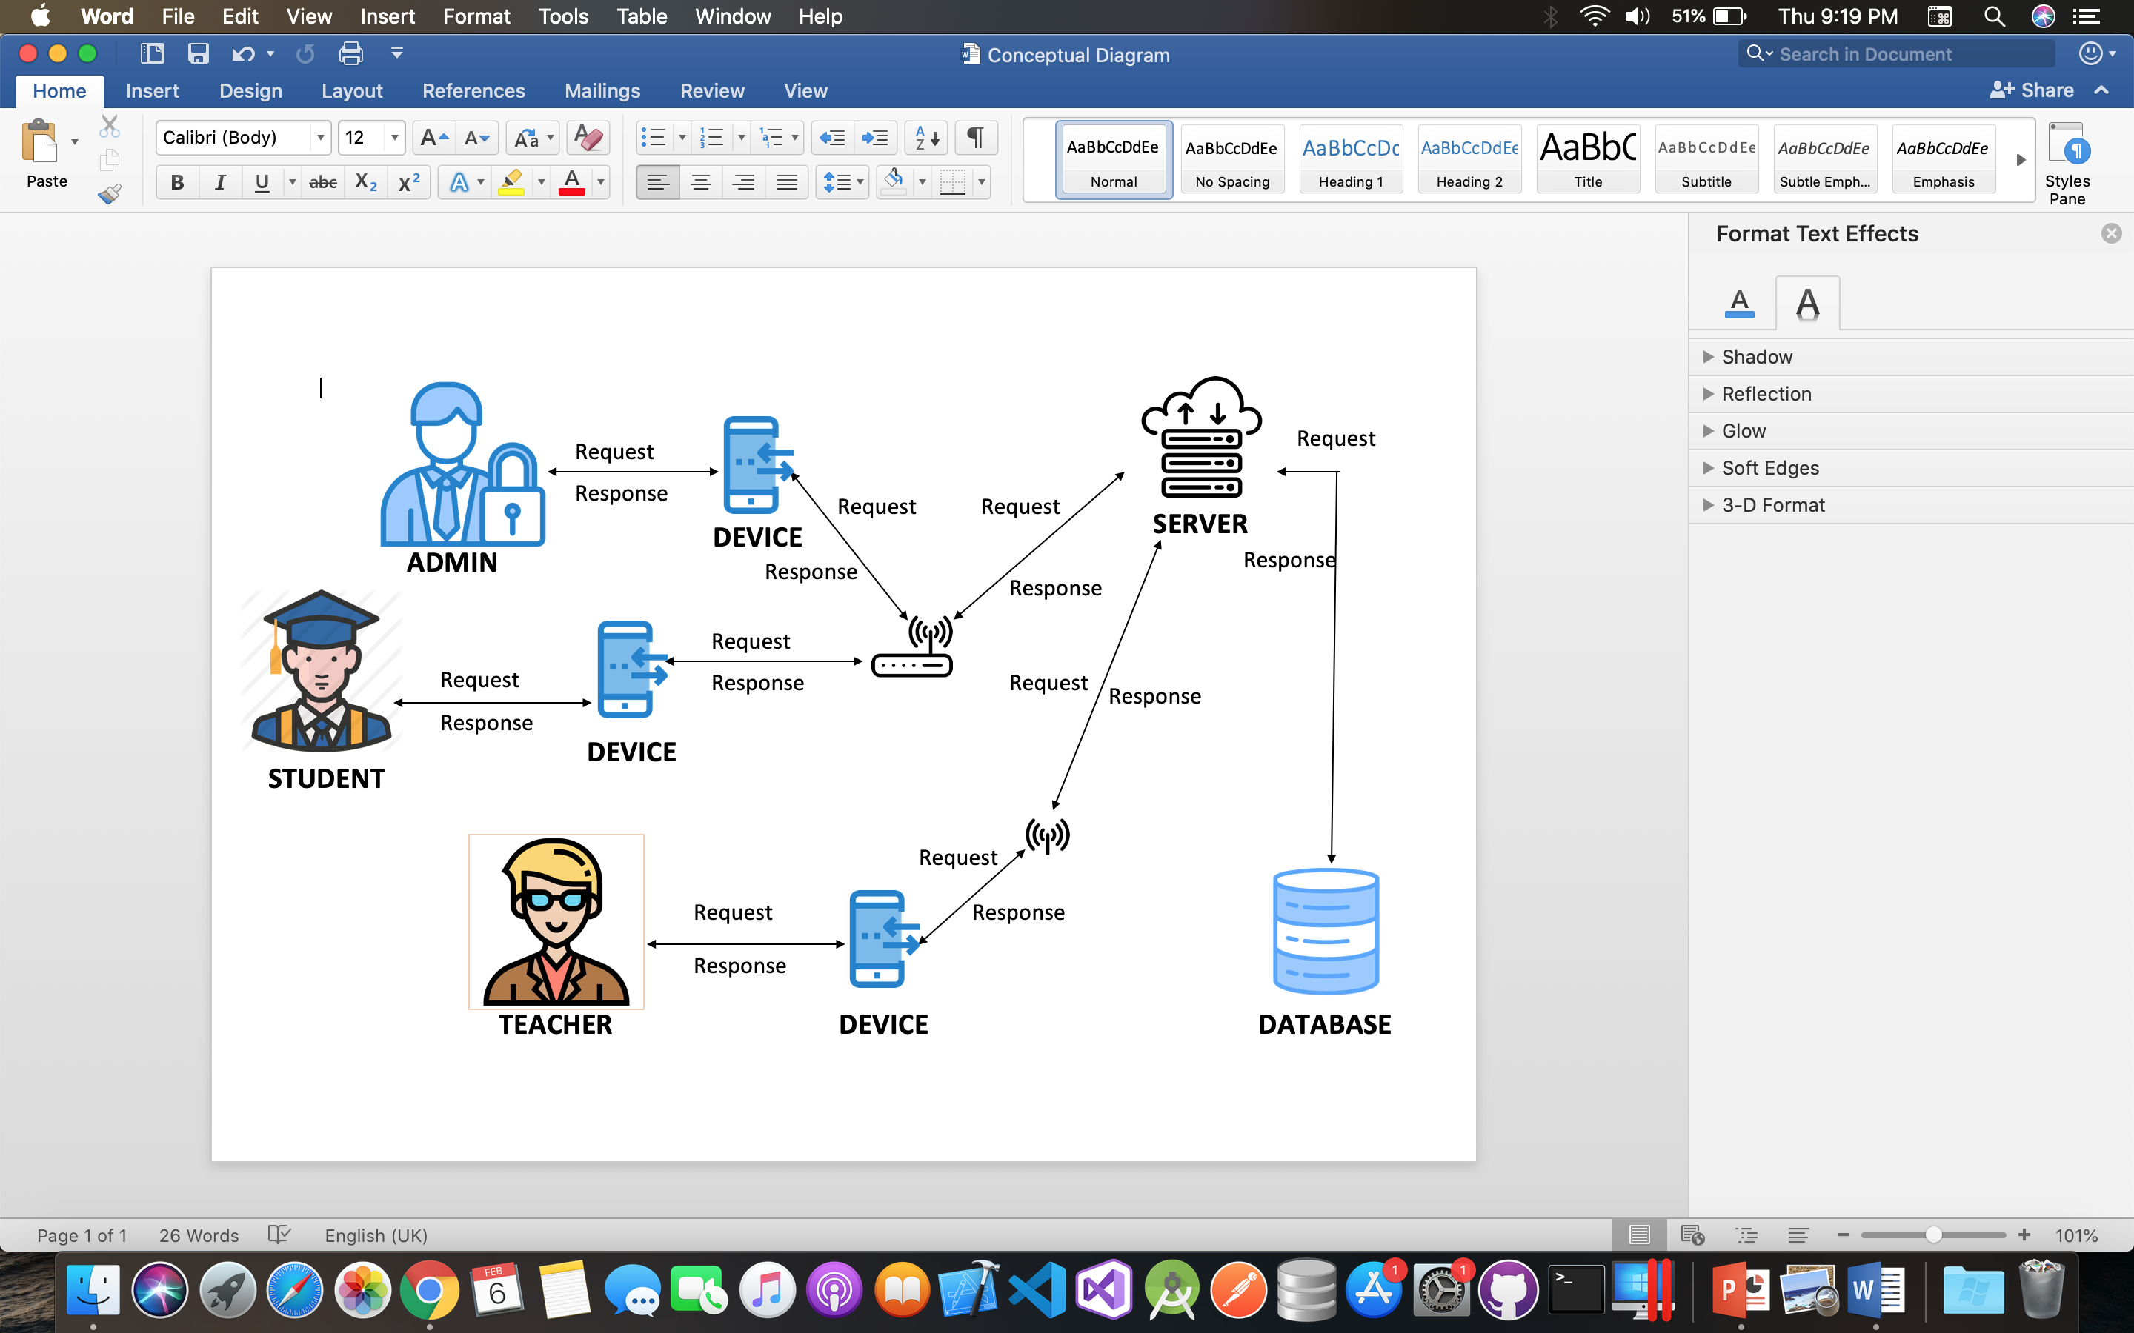
Conceptual Diagram

Slide 9
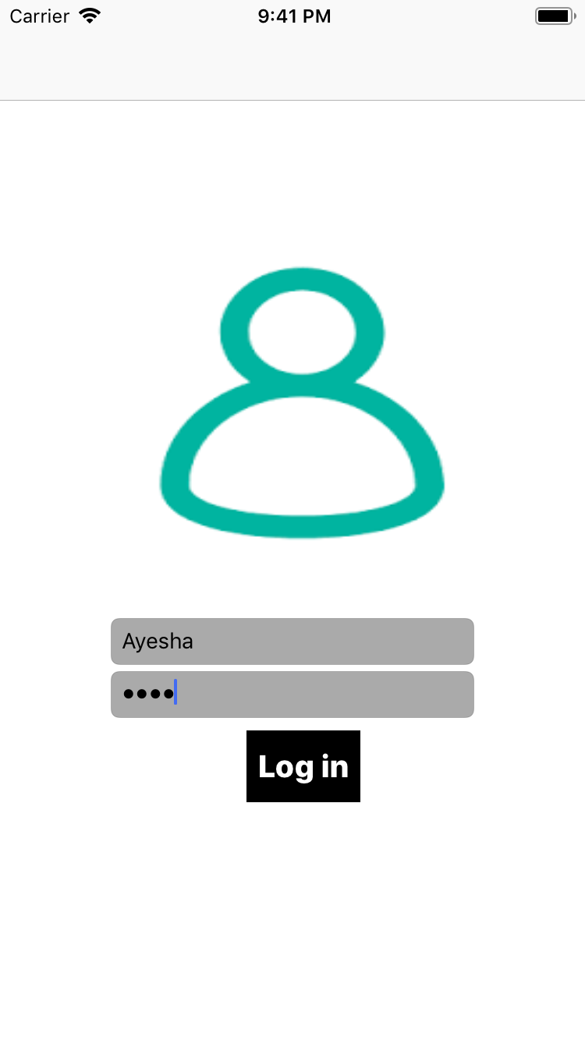
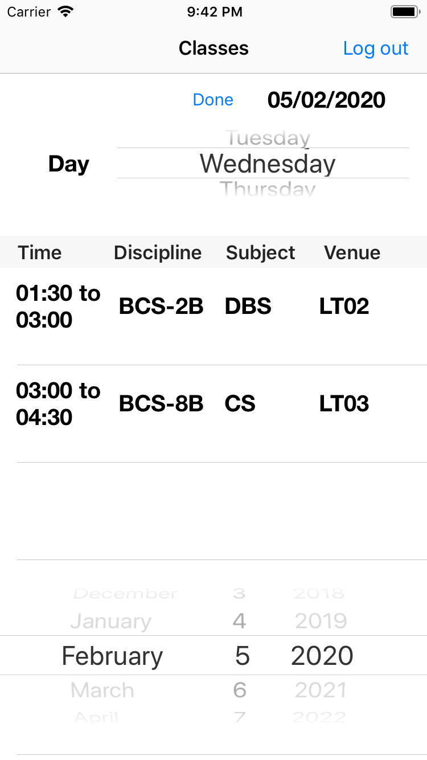
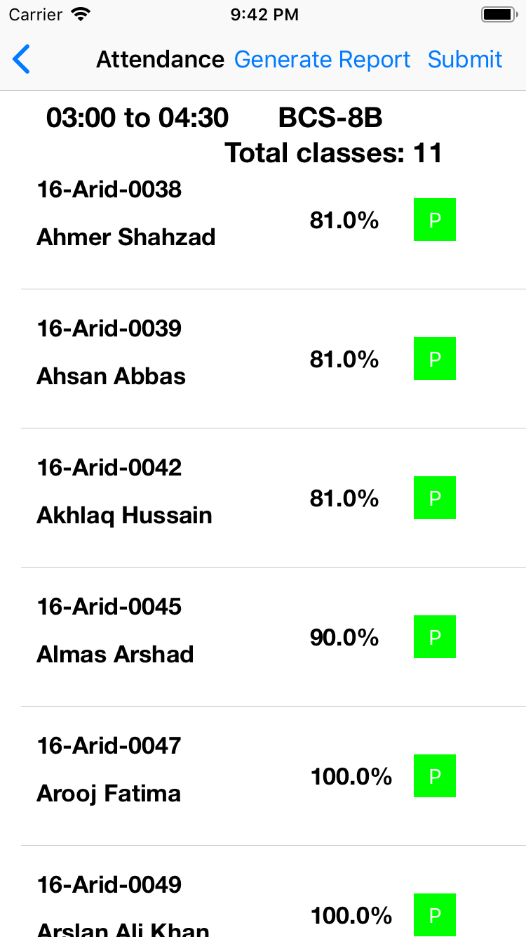
Teacher Screens

Slide 10
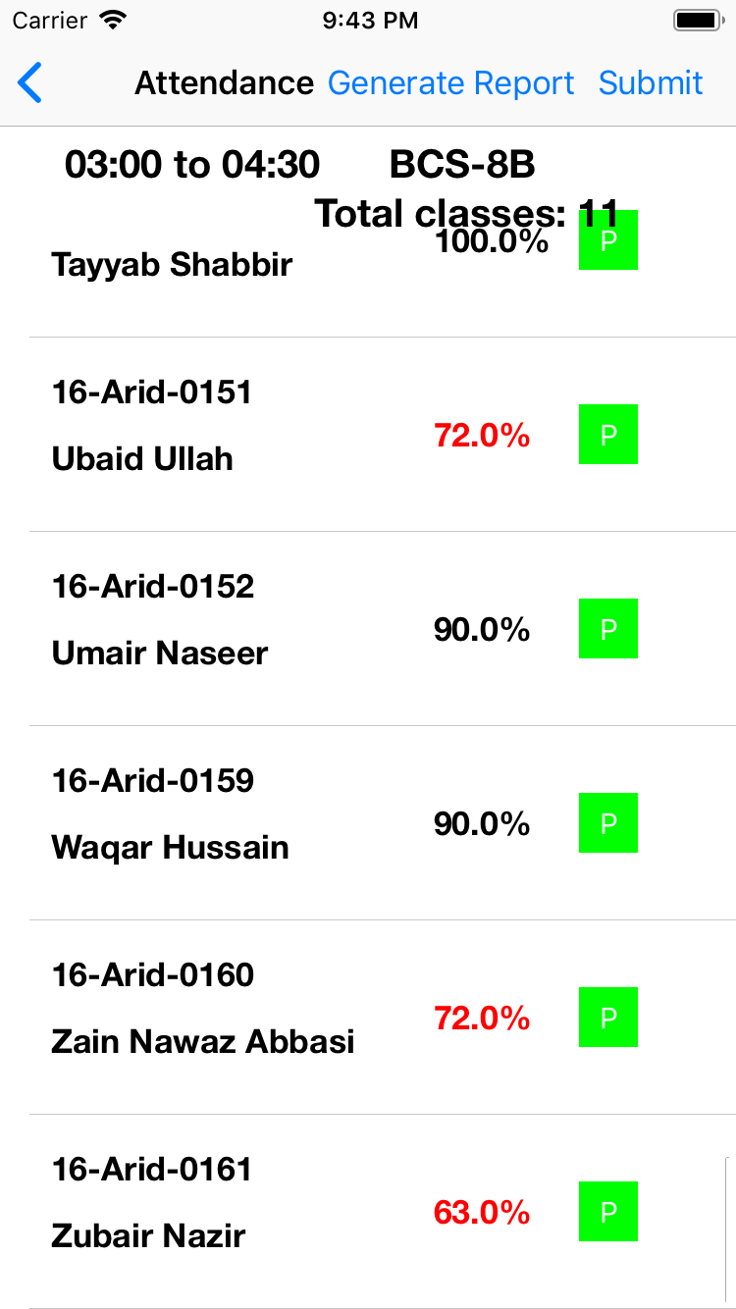
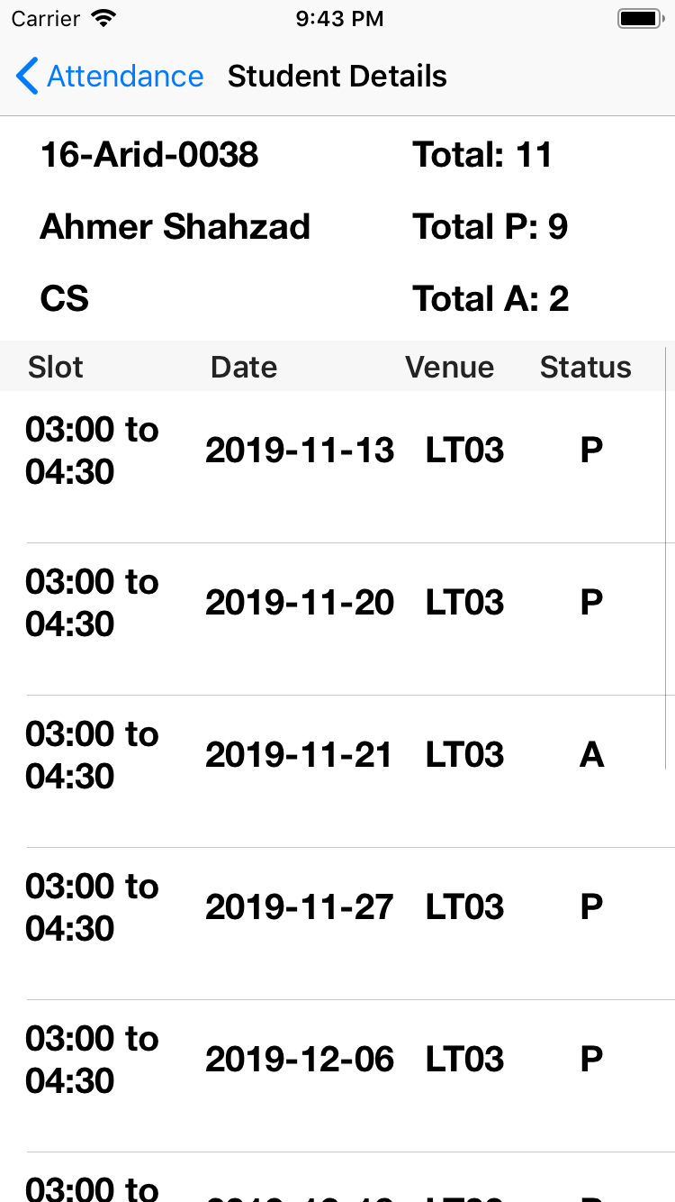
Teacher Screens

Slide 11

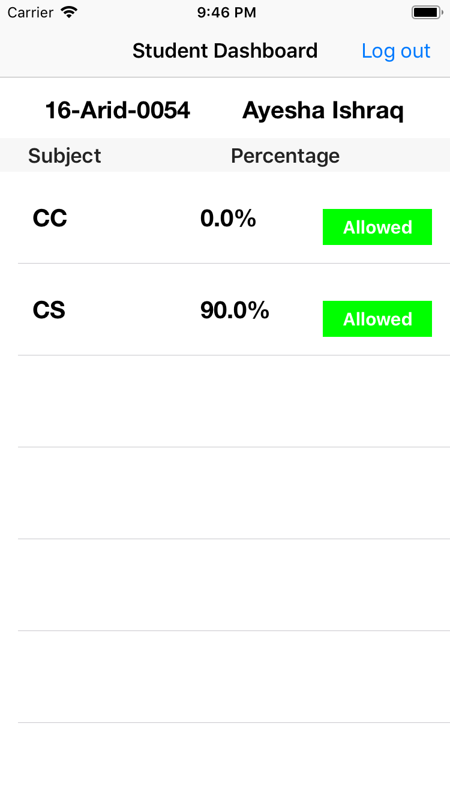
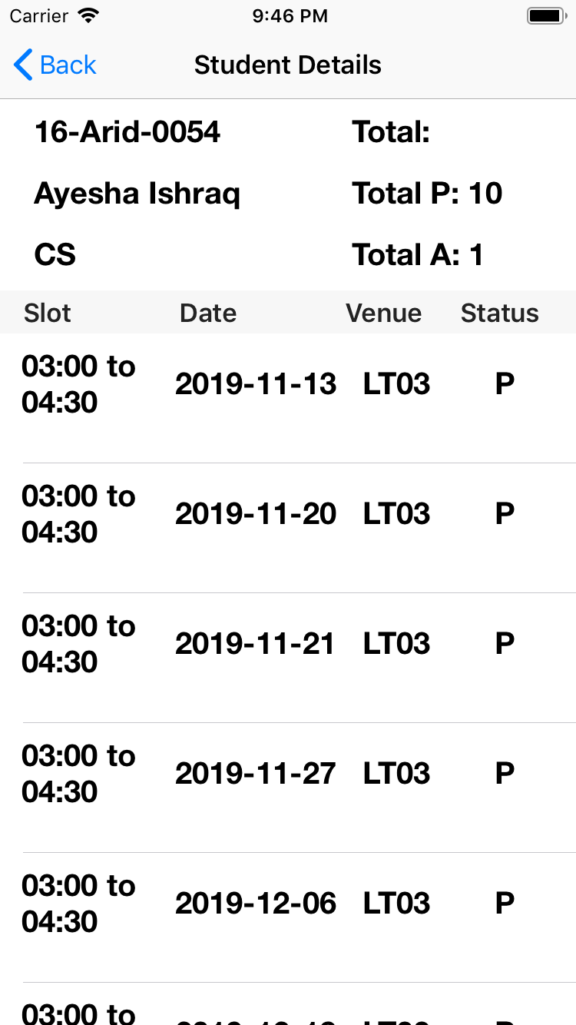
Student Screens

Slide 12
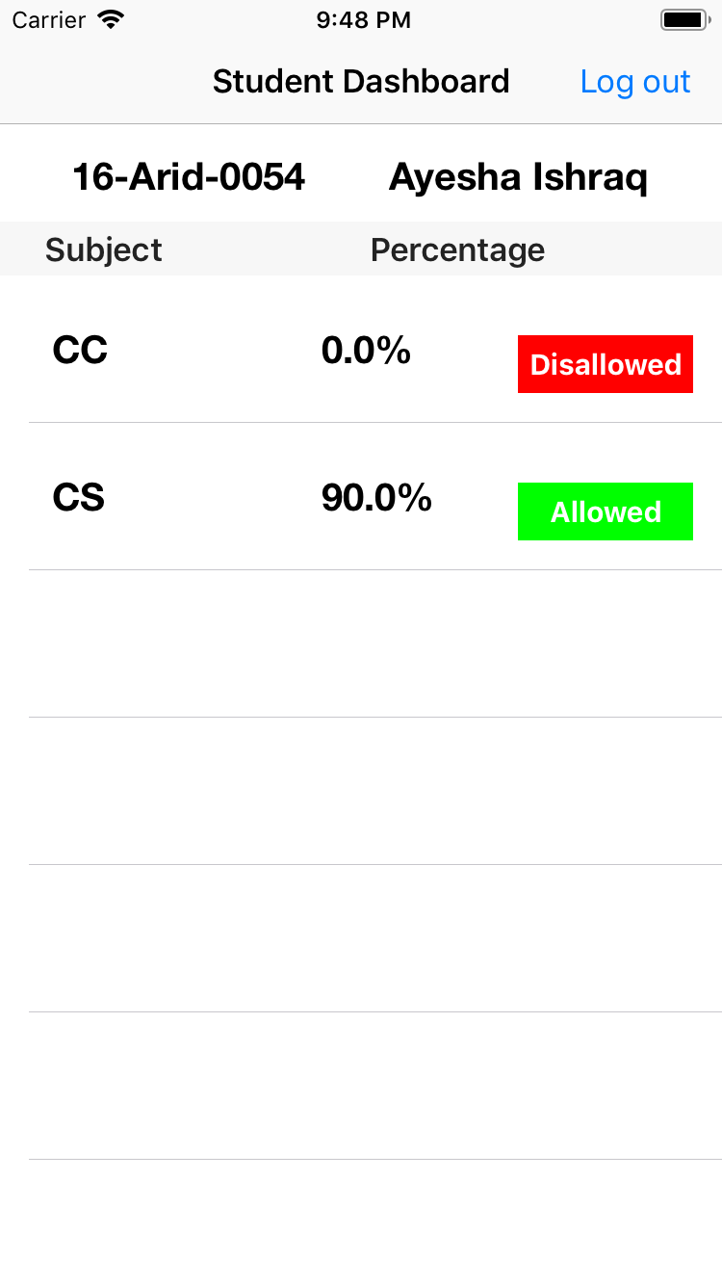
Student allow / disallow Parent from viewing Attendance

Slide 13

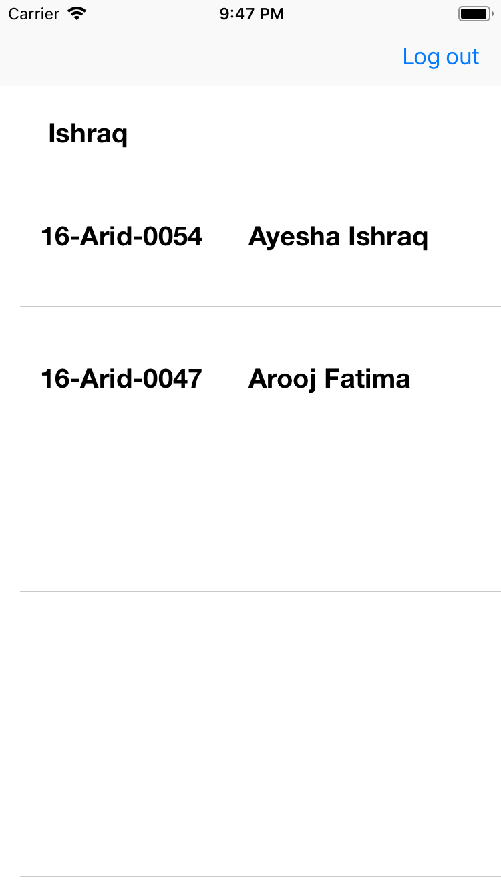
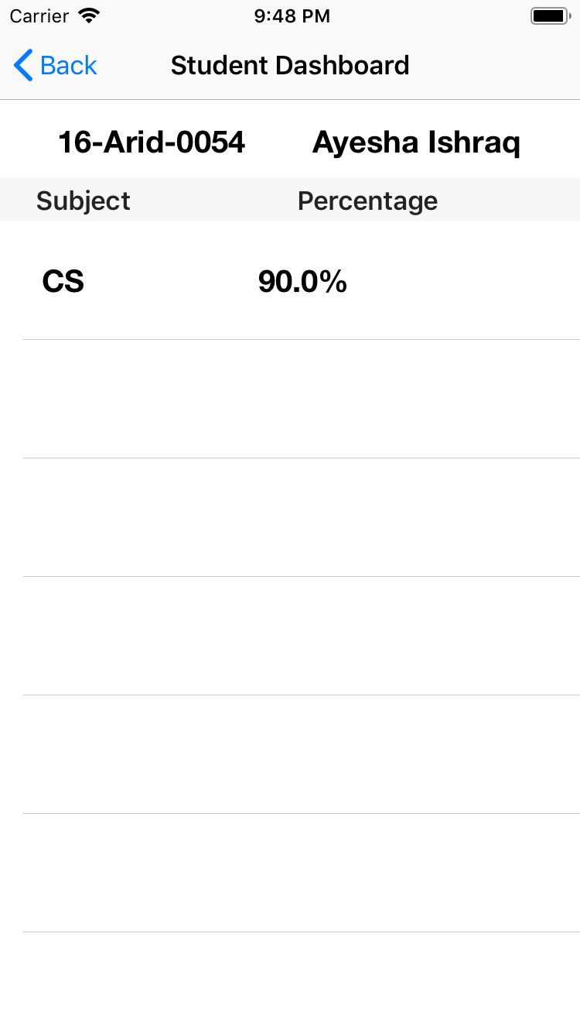
Parent Screens

Slide 14
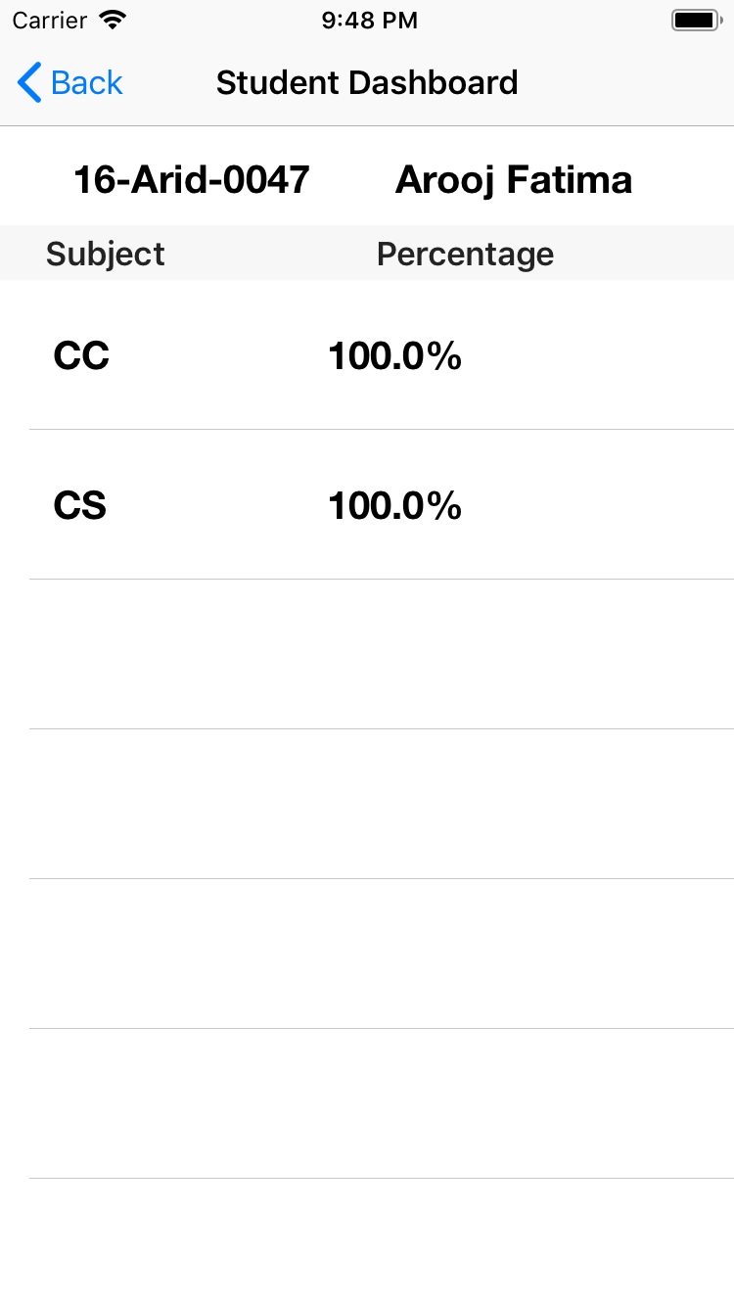
Parent Screens

Slide 15

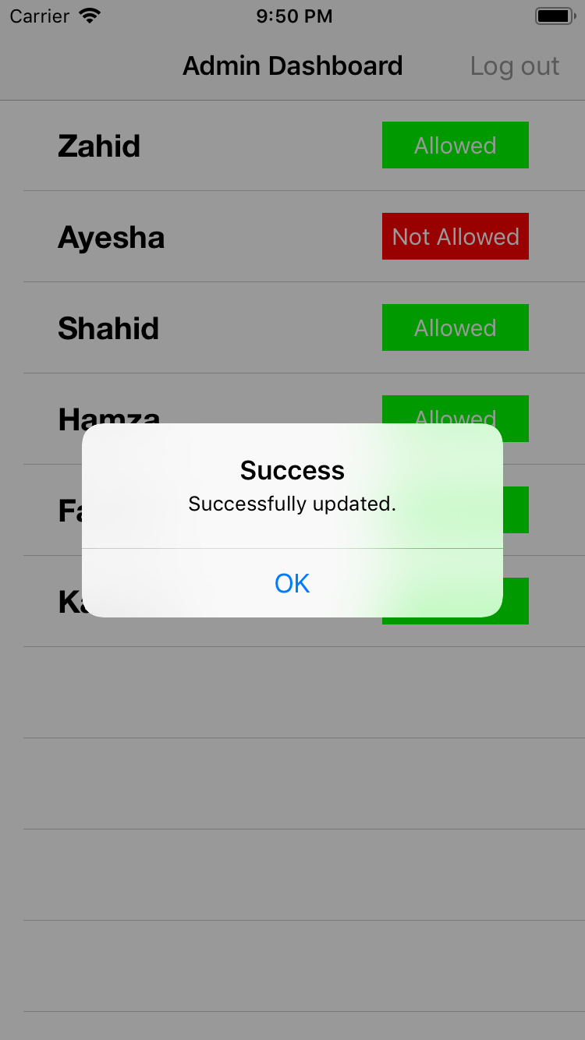
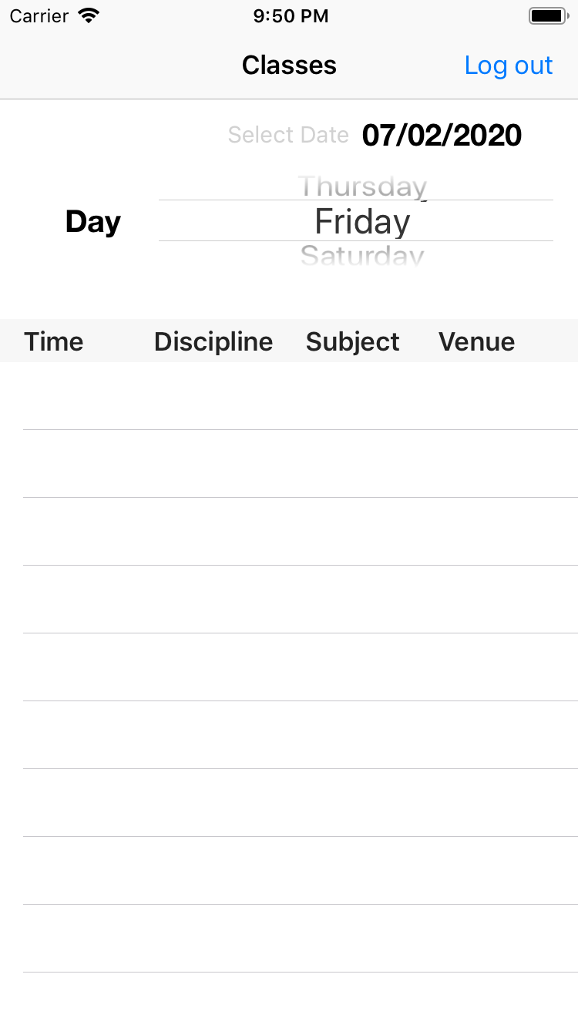
Admin Screens

Slide 16

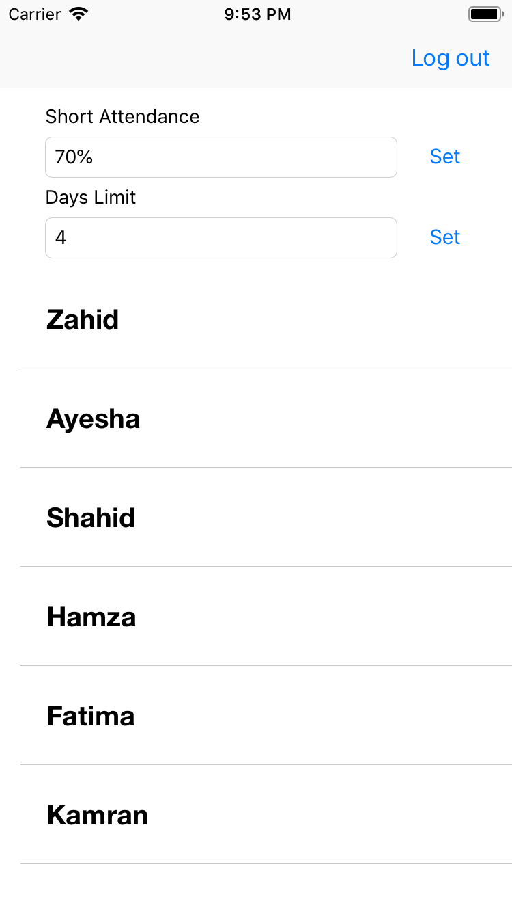
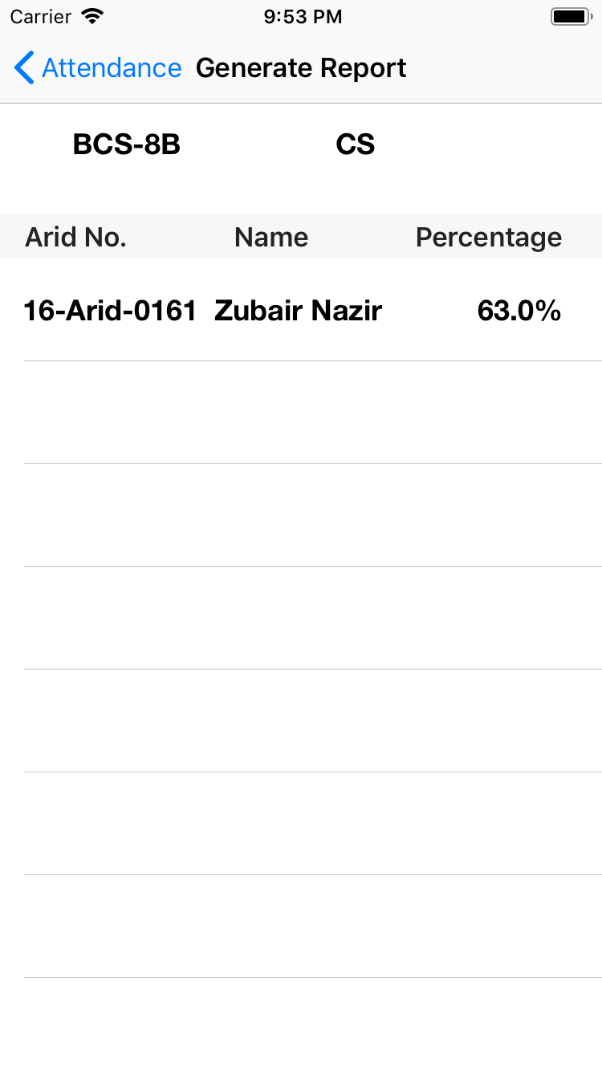
Director Screens

Slide 17
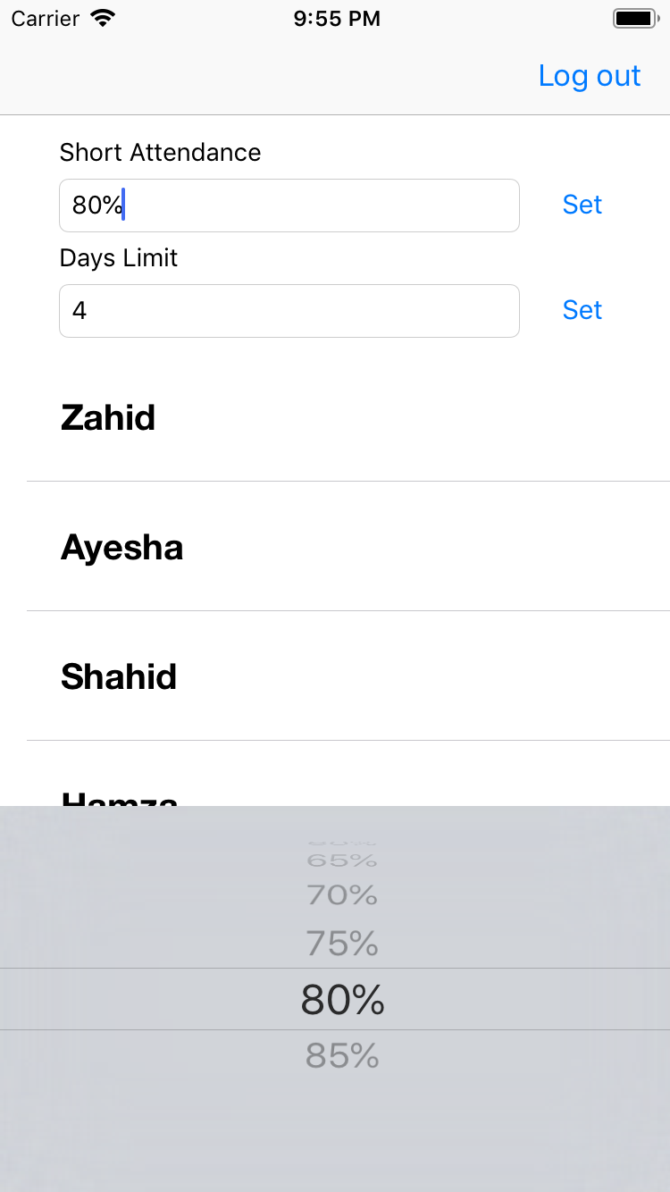
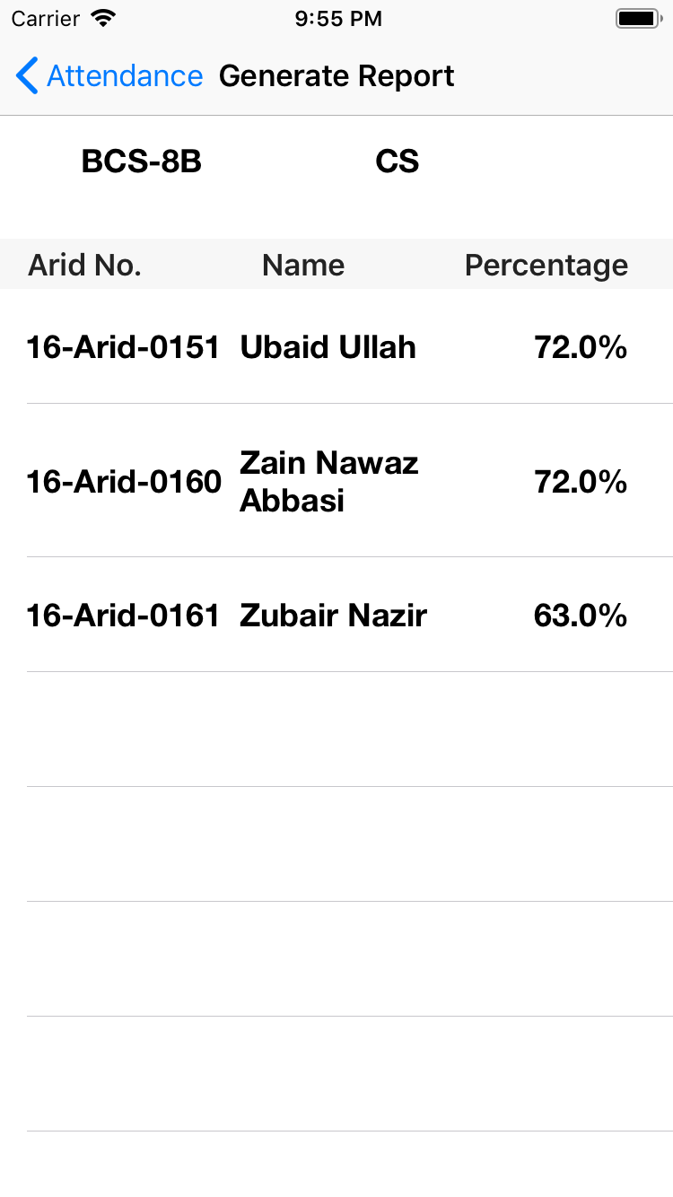
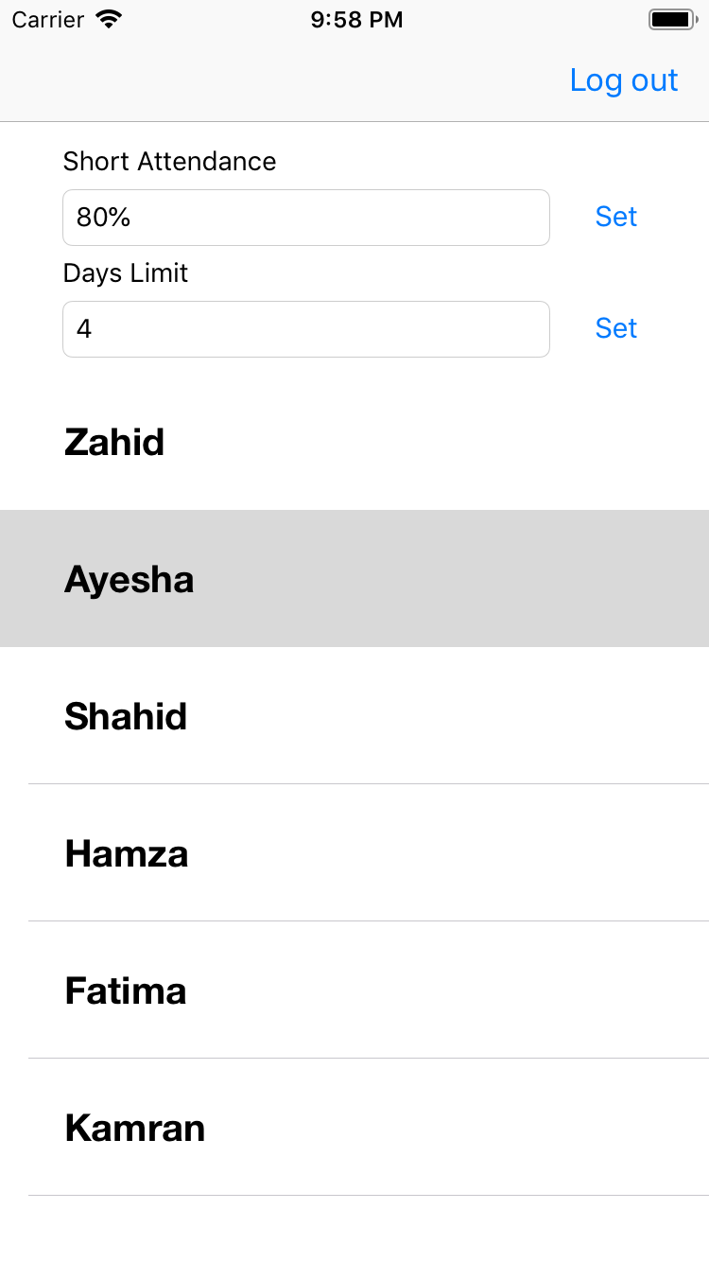
Director Screens

Slide 18
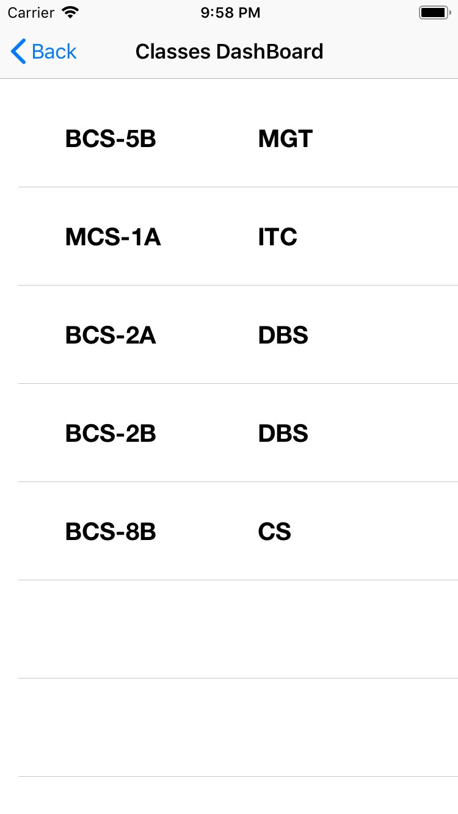
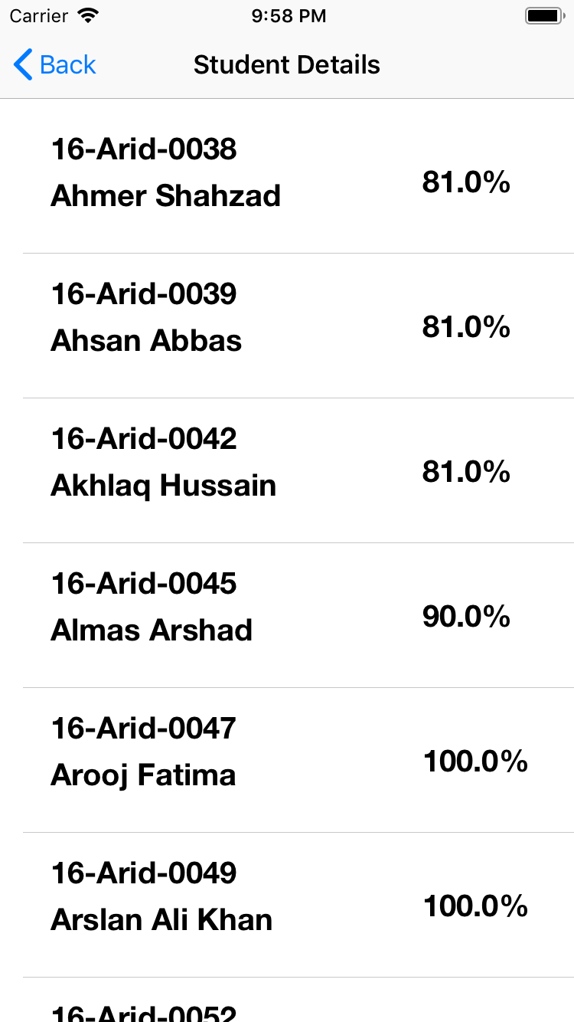
Director Screens

Slide 19
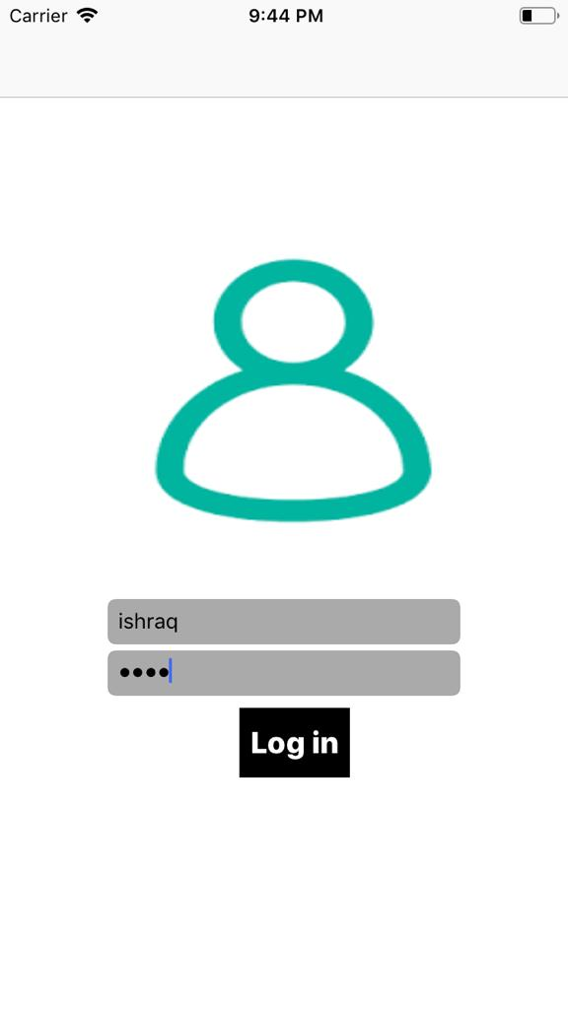
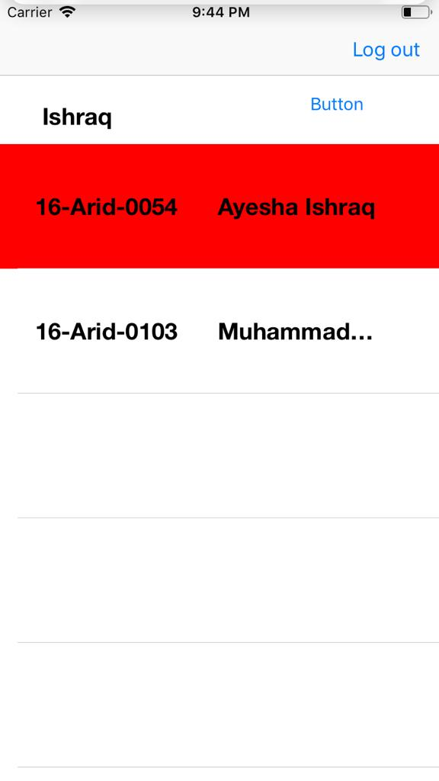
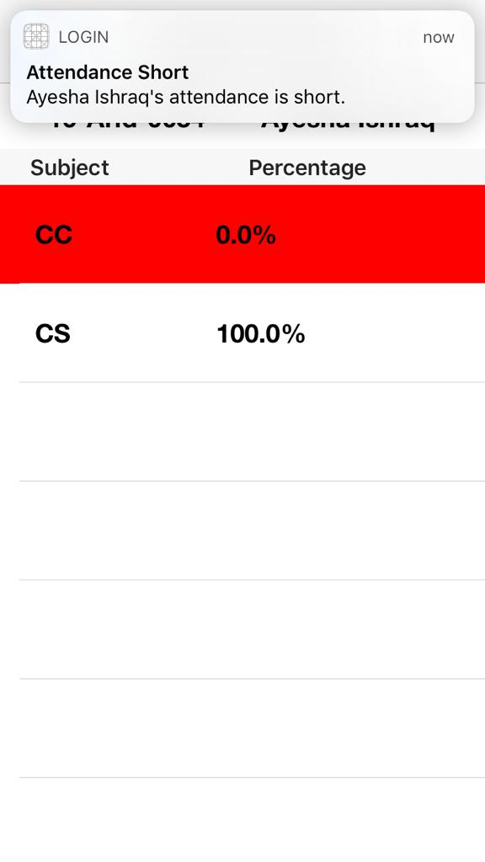
Notification Alert

Slide 20
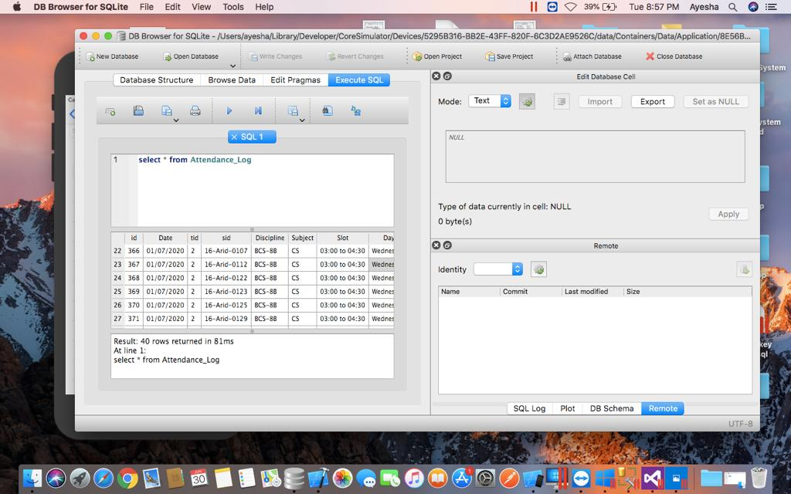
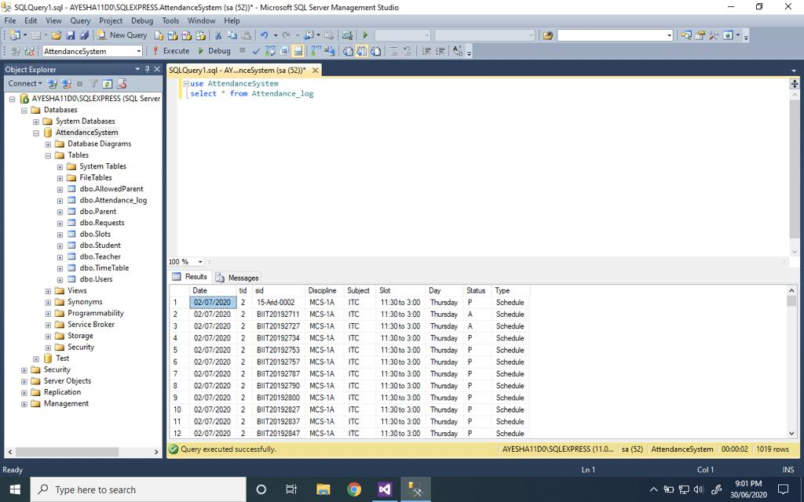
Auto Sync Attendance
When Offline
When Online

Slide 21
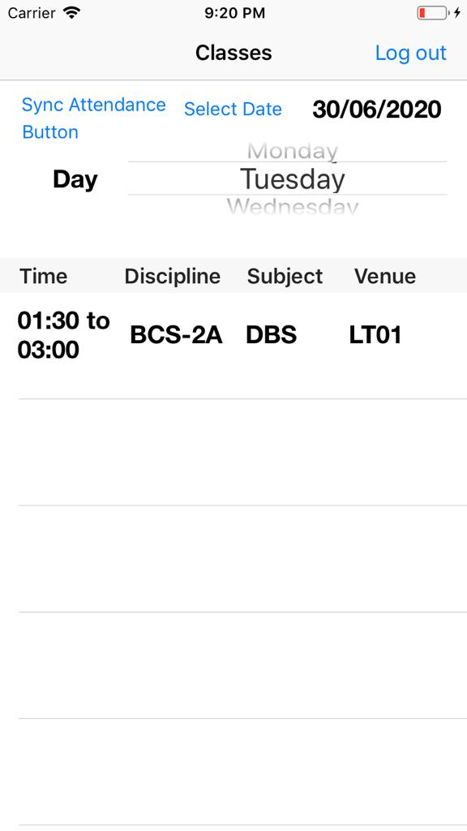
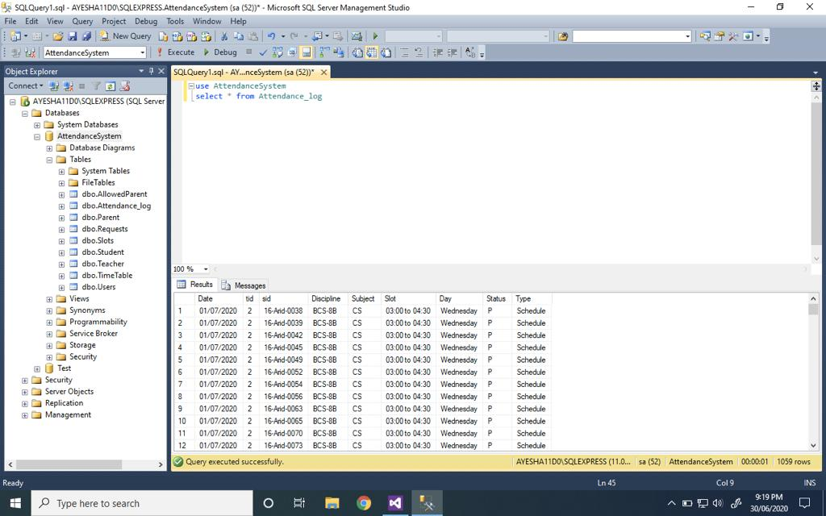

Slide 22
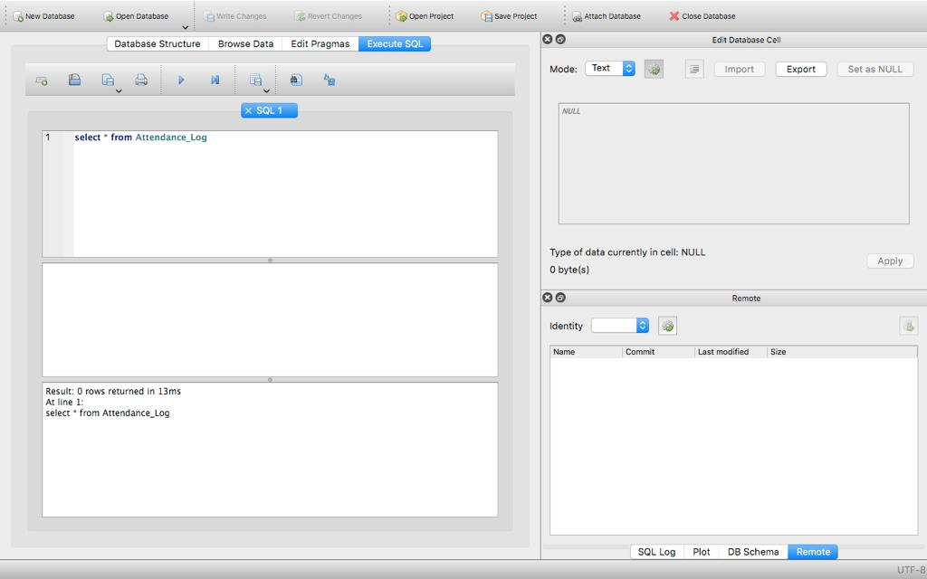

Slide 23
TOOLS & TECHNOLOGIES
Tools:
Microsoft Visual Studio (2019)
Xcode 10.1
MS SQL Server (2018)
Technologies:
Swift 4.2
C#

Slide 24
THANK YOU

